Slide 1
Prandtl Meyer Expansion
AE 2010:
Thermodynamics and Fluids Fundamentals

Slide 2
Supersonic Flow Turning
Previously, we examined supersonic flow over (sharp) concave corners/turns
  Oblique shock allows flow to make this (compression) turn
What happens if
  Turn is convex (expansion) already shown expansion “shock” impossible (entropy would be destroyed)
  Turn is gradual (concave or convex)
M₁>1
M₁>1
M₁>1
M₂>M₁
M₁>1
M₂>M₁

Slide 3
Gradual Expansion Turn
Gradual turn is made up of large number of infinitesimal turns/corners
Each turn has infinitesimal flow change
  Each turn produced by infinitesimal wave → Mach wave
Flow is uniform and isentropic between each turn/corner
  Length between each is arbitrary
  Could be zero length (sharp turn) and waves collapse to one point
M₁>1
M₂>M₁
δ
M₁
M_{a}
M_{b}
δ
M₂
M₁
M₂
δ

Slide 4
Prandtl Meyer Expansion Fan
Problem
  Given upstream conditions (1) and turning angle (δ)
  Find downstream conditions (2)
Goal
  Mach number relations (similar to shock relations)
Equations
  Use mass, momentum, energy conservation, Mach number def’n., state equation
Assumptions
  Steady flow, quasi-1D, reversible + adiabatic (isentropic)
Prandtl Meyer Fan
M₁
M₂
δ

Slide 5
Mach Relations
Approach
  Begin with single Mach wave that expands supersonic flow through an infinitesimal (differential) angle of magnitude dv
  Essentially using differential control volume
Mass/Momentum conservation
  Using same type of approach as for oblique shocks (two momentum components: t, n)
  Find lack of pressure gradient tangent to wave gives v_{t}=constant across wave
v_{t}
v_{n}
v_{t}
v_{n}+dv_{n}
μ
v
μ
dν
μ+dν
v+dv

Slide 6
Relation Between Velocity and Angles
Use v_{t}=constant
v_{t}
v_{n}
v_{t}
v_{n}+dv_{n}
μ
v
μ
dν
μ+dν
dv
v+dv
1

Slide 7
Relation Between M and dv
Relate v and M
v
μ
dν
v+dv

Slide 8
Relation Between M and dv
Relate these two eqns
Need finite angle, δ=v₂-v₁ and finite ΔM
M
μ
dν
M+dM
dM is change in Mach number associated with dv turn angle
M₁
δ
integrate
M₂

Slide 9
M-v Relations
Perform Integration
So, given δ(=v₂-v₁) and M₁
  Could solve for M₂
Can not invert analytically (M₂=f(M₁,δ))
  Either use iterative (e.g., numerical or guessing) method
  Or find v as a function of M and tabulate or graph solution
M₁
δ
M₂

Slide 10
Tabular solutions/Reference Condition
Want to find v=v(M) [really v₂=v₂(M₂)] for any M
  Need to choose (arbitrary) reference condition, i.e., pick an M where v=0
  Let’s choose v=0 at M=1
v represents angle through which a sonic flow would have to turn to reach M
Analogous to table of h(T)
Really h(T)-h(T_{ref})
Just chose h(T_{ref})=0
M₁
M=1
ν₁
δ =ν₂-ν₁
ν₁ is turn angle for M=1 to M₁
M₂

Slide 11
Using the Prandtl Meyer Tables
To find M₂ given M₁ and δ
  Find v₁ (for given M₁) from table
  Get v₂ from δ=v₂-v₁
  Look up v₂ in table to find M₂
To find T₂, P₂,…
  Use isentropic flow relations since expansion is isentropic (no shock)
  e.g.,
M₁
δ =ν₂-ν₁
M₂
T_{o}=const

Slide 12
Example
Given: uniform Mach 2 flow of nitrogen at 300 K flows over compound wall corner: two turns, 20º and 6º
Find: M and T after final turn
Assume: N₂ is TPG/CPG with γ=1.4, steady, adiabatic, no work, inviscid,…
M₁
20°
6°

Slide 13
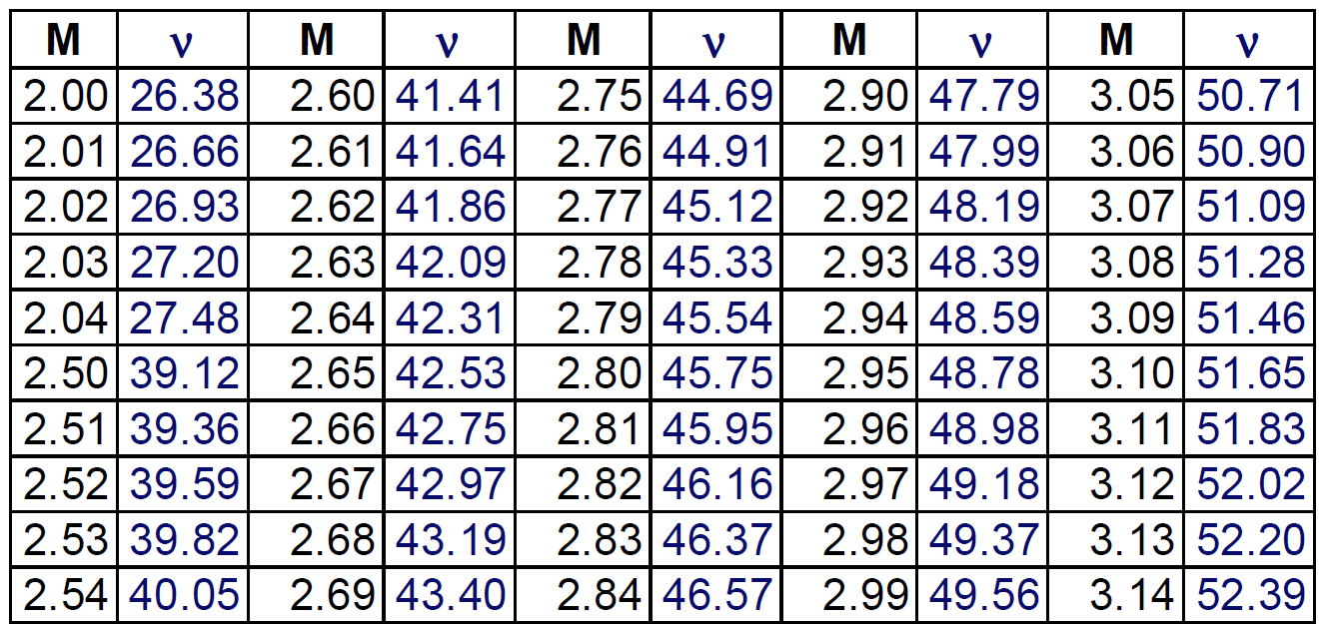
Example
Analysis:
  First, 1-2
  Next, 2-3
  Note: did not need to do intermediate step
  T₃
M₁
M₂
20°
M₃
6°
Only total turning angle is important

Slide 14
Prandtl Meyer Fan Angle
Fan angle
  Angle between first and last Mach wave
  Useful to determine when expansion has ended in flowfield for a given distance away from wall
From geometry
  Fan Angle = μ₁-(μ₂-δ)= μ₁-μ₂+δ=(μ₁-μ₂)+(ν₂−ν₁)
Fan Angle
M₁
μ₁
M₂
δ
μ₂-δ

Slide 15
Prandtl Meyer Turns at High M
Examine plot of v as function of M
M₁
δ =ν₂-ν₁
M₂
θ_{max}
As M increases, reach maxi turn angle (v_{max}~130.5º for γ=1.4)
So as M₁ increases, max. angle flow can turn (δ_{max}) decreases
p→0
Example
M₁=2
δ_{PM}<104.1°
δ
M₂

Slide 16
Maximum Turn Angle
Analytic Expression
As γ decreases (higher temperatures, bigger molecules), maximum turn angle increases
δ_{max} smaller in real flows , T and P drop through turn
  Condensation of gas
  Non-equilibrium flow
90º
γ=5/3
130.45º
γ=1.4
159.2º
γ=1.3
208.5º
γ=1.2

Slide 17
Continuous (Smooth) Expansions
Already showed that it does not matter if expansion turn is sharp or smooth
  Still get same solution, P-M fan=infinite set of Mach waves
  Unless we exceed the maximum turning angle, final properties just function of total turn angle
  Smooth turn just means expansion process takes place over longer distance
M₁>1
M₂>M₁
δ

Slide 18
Continuous (Smooth) Compressions
What happens if we have a smooth concave turn?
  since flow direction change is small, can still get set of weak Mach waves
Prandtl-Meyer compression: δ=-(v₂-v₁), so v₂-v₁<0
  However unlike expansions, compressions merge
  Together they coalesce to form oblique shock
  Flow that went through PM compression is isentropic, outer flow has entropy rise (P_{o} loss)
  Size of PM region depends on M₁ and curvature
M₂<M₁
M₁>1
δ

